Slide 1
Root of an Equation

Slide 2
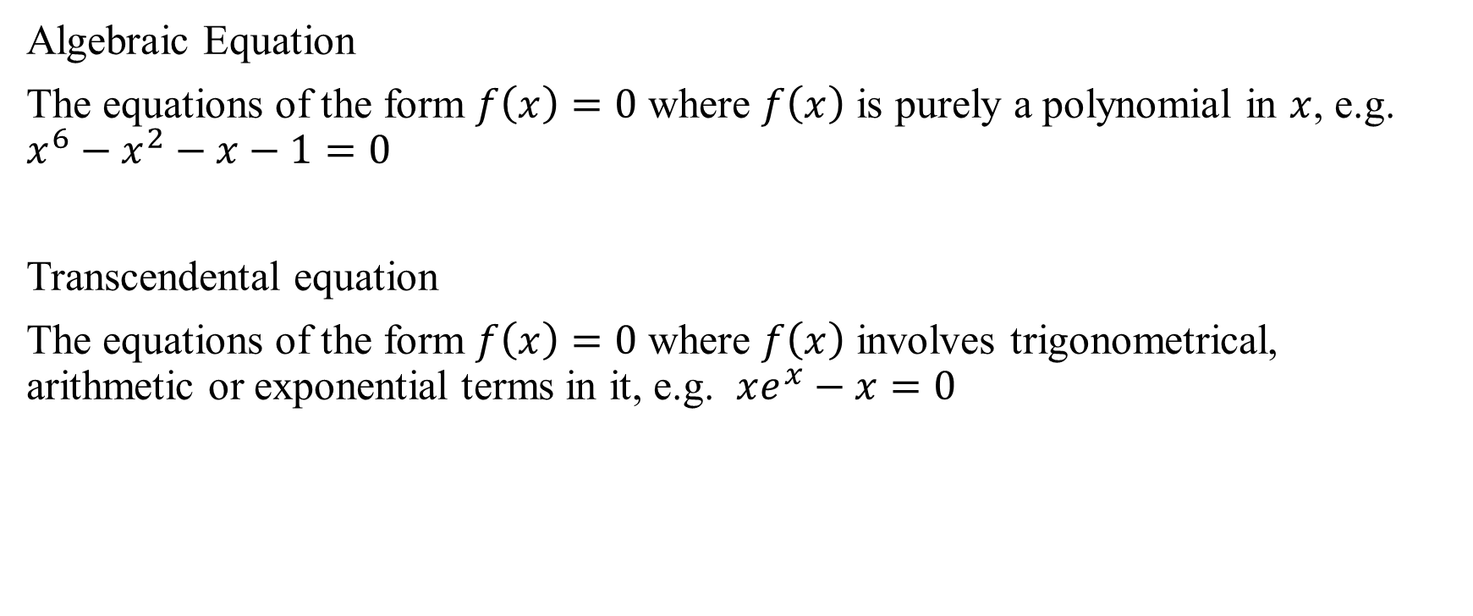
Mathematical Background: Different Equations
Algebraic Equation
The equations of the form $f\left(x\right)=0$ where $f\left(x\right)$ is purely a polynomial in $x$, e.g. $x^{6}−x^{2}−x−1=0$
Transcendental equation
The equations of the form $f\left(x\right)=0$ where $f\left(x\right)$ involves trigonometrical, arithmetic or exponential terms in it, e.g. $xe^{x}−x=0$

Slide 3

Mathematical Background: Basic Properties of Algebraic eqn.
If $f\left(x\right)$ is divisible by $\left(x−a\right)$ then $a \text{is} \text{a} \text{root} \text{of} f(x)$
Every algebraic equation of $n$th degree has $n$ and only $n$ real or imaginary roots.
If $f\left(x\right)$ is continuous in the interval $[a, b]$and $f\left(a\right), f\left(b\right)$ have different signs, then the equation have at least one root between $x = a \text{and} x = b$ (Intermediate value theorem)

Slide 4
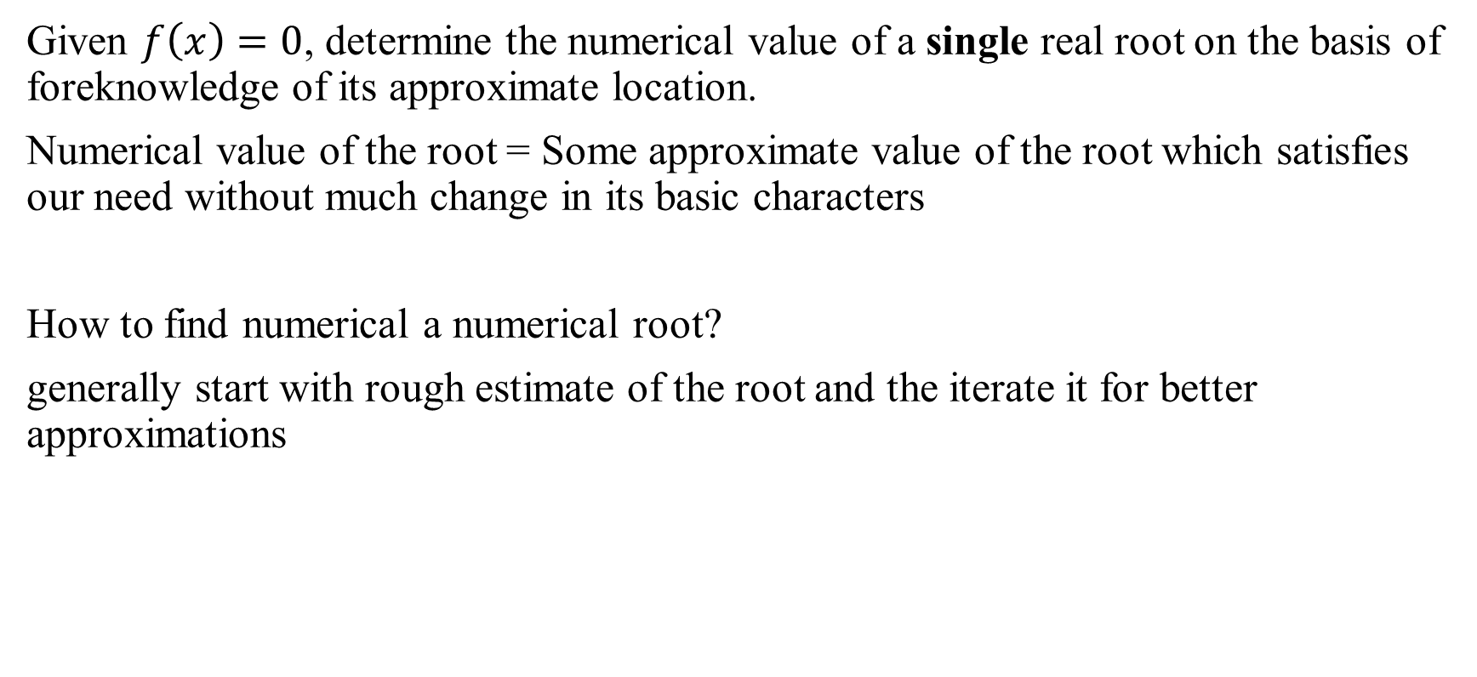
Task: Numerical Computation of roots
Given $f\left(x\right)=0$, determine the numerical value of a single real root on the basis of foreknowledge of its approximate location.
Numerical value of the root = Some approximate value of the root which satisfies our need without much change in its basic characters
How to find numerical a numerical root?
generally start with rough estimate of the root and the iterate it for better approximations

Slide 5
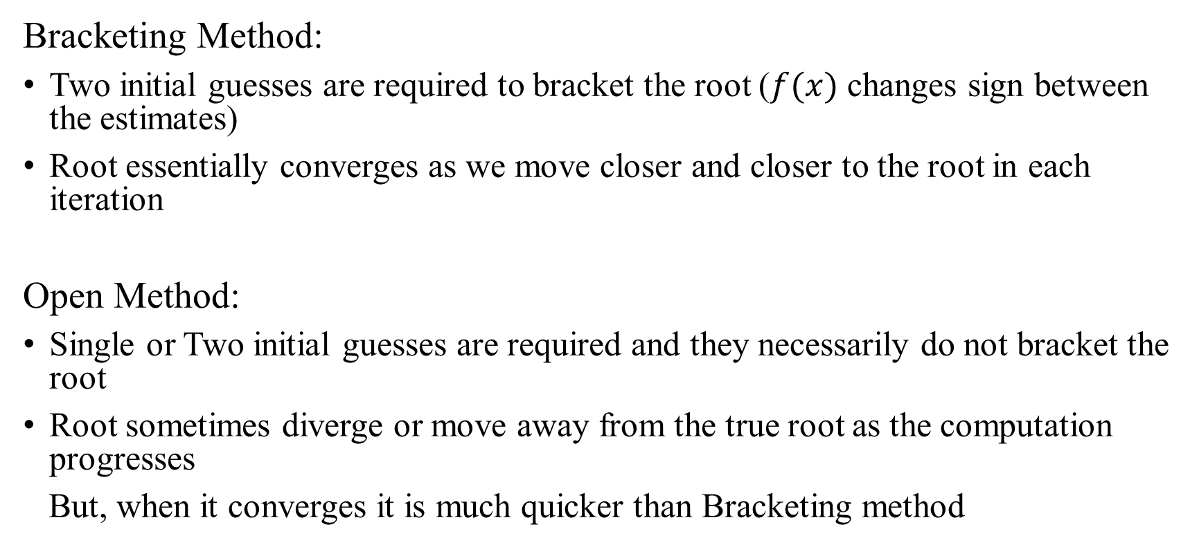
Methods for numerical computation of roots
Bracketing Method:
Two initial guesses are required to bracket the root ($f(x)$ changes sign between the estimates)
Root essentially converges as we move closer and closer to the root in each iteration
Open Method:
Single or Two initial guesses are required and they necessarily do not bracket the root
Root sometimes diverge or move away from the true root as the computation progresses
But, when it converges it is much quicker than Bracketing method

